Slide 1


Life Expectancy Analysis
This analysis explores the trends, metrics, and implications of global life expectancy, highlighting its significance in public health and societal development. We will examine historical progress, current disparities, and the impact of recent global events.

Slide 2


What is Life Expectancy?
Life expectancy represents the average number of additional years a person can expect to live if current mortality rates continue. It's a statistical measure, not a prediction for any single individual.
Period Life Expectancy
Calculated based on current mortality rates for all age groups in a given year.
Cohort Life Expectancy
Tracks a specific group of people born in the same year throughout their lives.

Slide 3
Historical Trends in Life Expectancy
Global life expectancy has more than doubled in the last two centuries, a testament to human progress in health and living conditions.
Early 1900s
Global average life expectancy hovered around 32 years, primarily due to high infant mortality rates and
infectious diseases.
1
2
Mid-20th Century
Advances in antibiotics, vaccines, and public health initiatives led to significant increases.
2021
Global average surged to over 70 years, driven by ongoing medical innovation and economic growth.
3

Slide 4

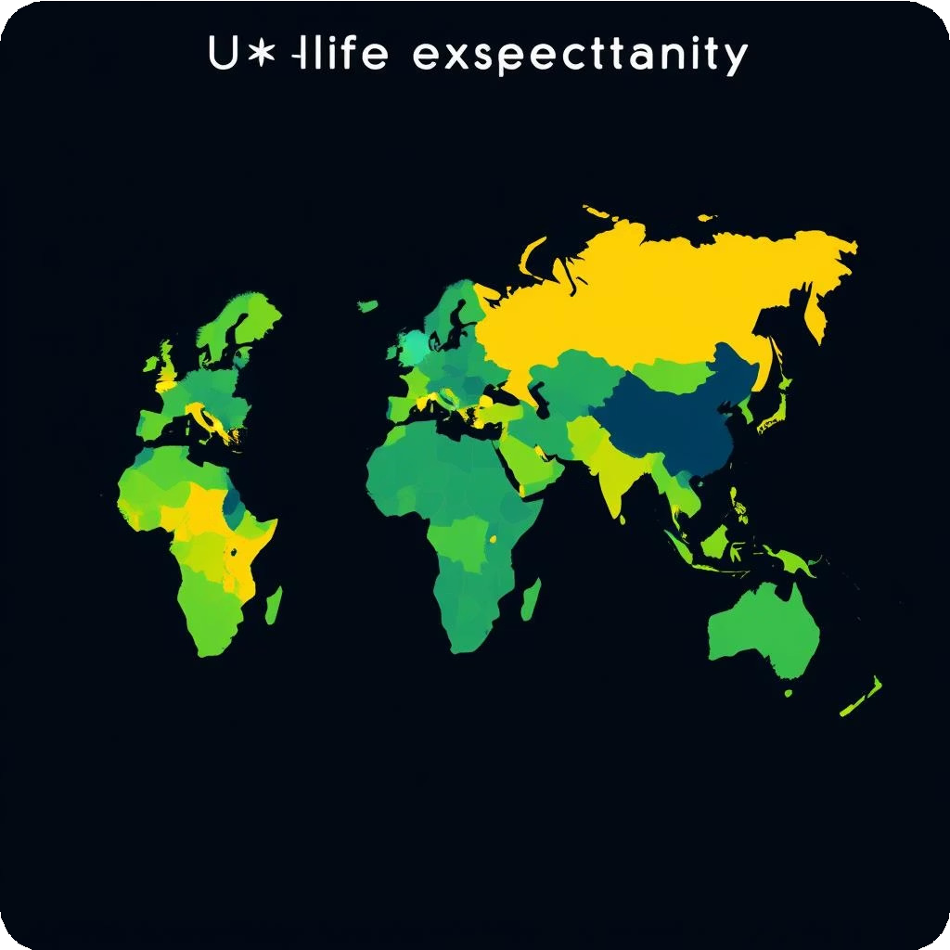
Global Life Expectancy Today
As of 2023, the global average life expectancy is approximately 71 years, but significant disparities persist across regions, ranging from 53 to over 85 years.
Healthy Life Expectancy (HALE), which accounts for years lived in full health, often lags behind total life expectancy.
71 53-85+
Years Years
Global average life Regional variations expectancy (2023 estimate) worldwide

Slide 5
Measuring Life Expectancy: Data & Methods
Life expectancy calculations rely on comprehensive data and sophisticated methodologies.
1 2 3
Life Tables
Period life tables from organizations like the UN, WHO, and CDC are fundamental.
Mortality Rates
Calculations incorporate age- specific and sex-specific mortality rates from various regions.
Limitations
Data gaps in developing regions and assumptions in projections can affect accuracy.

Slide 6

Impact of COVID-19 on Life Expectancy
The COVID-19 pandemic significantly disrupted global life expectancy trends, reversing years of progress in a short period.
From 2019 to 2021, global life expectancy dropped by nearly two years. Healthy life expectancy also saw a significant decline. This setback erased approximately a decade of progress in some countries, highlighting the fragility of health gains in the face of major global crises.
90
60
30
0
2019
2021

Slide 7
Thank You!
We appreciate your time and attention to this critical analysis of global life expectancy. Together, we can continue to strive for a healthier and longer future for all.

